Slide 1
U.S. Airline Performance & Delay Analysis

Slide 2
Project Objectives
• Analyze U.S. airline flight performance trends
• Identify causes of delays, cancellations, and diversions
• Highlight performance by airline, airport, and time
• Provide actionable recommendations for stakeholders

Slide 3
Methodology
• Tools Used: PostgreSQL, Power BI
• Data Cleaning: Removed nulls, standardized codes
• SQL Integration: Joined flight, airline, airport datasets
• Dashboard Design: Multi-page with DAX-based KPIs

Slide 4
Key Findings
• Weather is responsible for 54% of all delays
• Spirit & Frontier have worst OTP and delays
• June sees highest cancellations due to summer travel
• Regional airports face high delays/cancellations
• Saturday has best OTP (85%), Thursday the worst

Slide 5
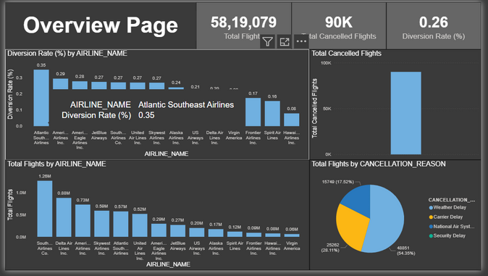
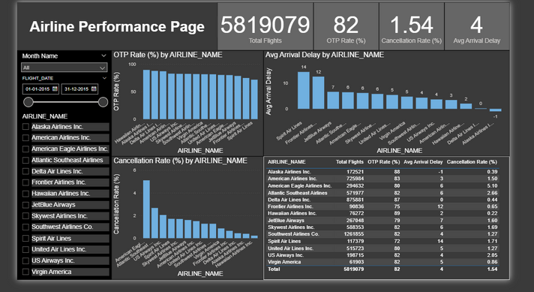
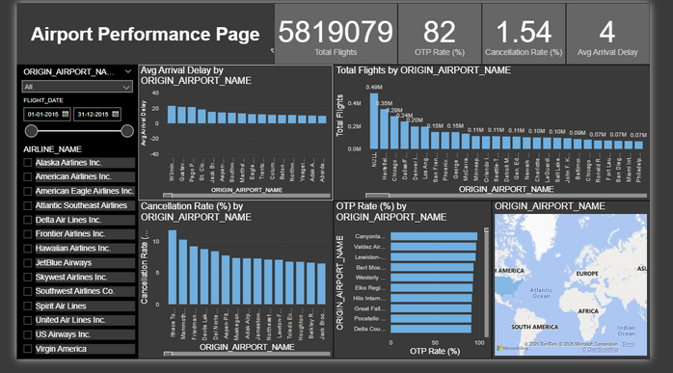
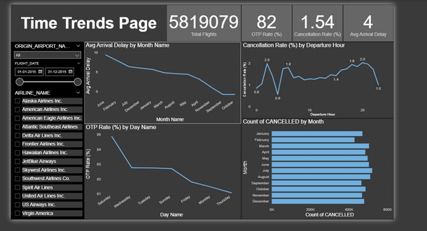
Dashboard Highlights
• Overview: KPIs like OTP Rate, Cancellation %, Avg Delay
• Airline View: Compares OTP, cancellations by airline
• Airport View: Highlights delay patterns by airport
• Time Trends: Patterns across months, weekdays, hours

Slide 6
Key Recommendations
• Improve infrastructure at small/regional airports
• Use AI to predict high-risk flights and weather events
• Optimize June operations with additional resources
• Audit low-performing airlines (Spirit, Frontier)
• Shift critical flights to Saturdays where possible

Slide 7
Conclusion
• Project provided clear insights from large datasets
• Dashboards enable stakeholders to optimize operations
• Recommendations aim to improve OTP and reduce delays
• SQL + Power BI offered a powerful analytical framework

Slide 8


